Slide 1
Cs 470 DMV DATABASE PROJECT
tEAM MEMBERS:
Brandon Volesky
Colby Chandler
Liam Floyd
Elizabeth Koch
Mao Zheng

Slide 2
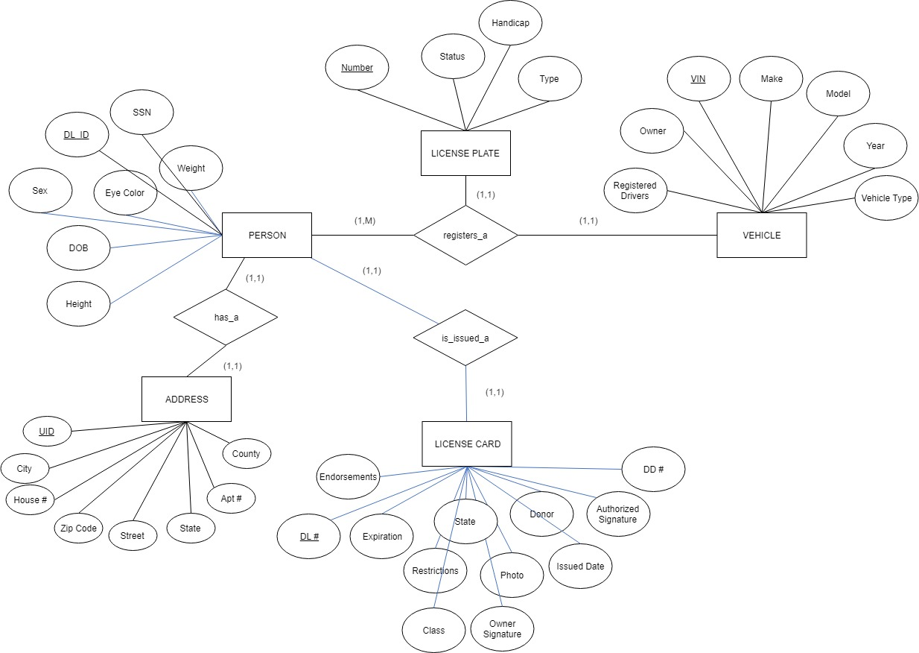
ER Diagram

Slide 3
Database architecture
This project will be utilizing the 2-tier architecture model of client-server.
The reasoning for selecting the client-server architecture was the correct fit for our query-based model. A level of simplicity was intended to be preserved by selecting this model. Because this database would only be operated by on premise employees of the DMV, our focus pivoted to internal development.

Slide 4
Database architecture
Pros:
Network peripherals are controlled centrally
Backups and network security are controlled centrally
All files are stored in a central location
Users can access shared data which is centrally controlled
Cons:
The server is expensive to purchase
Specialist staff such as a network manager is needed
If any part of the network fails a lot of disruption can occur

Slide 5
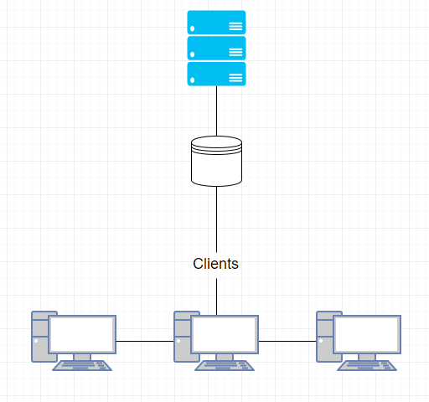
Database architecture

Slide 6
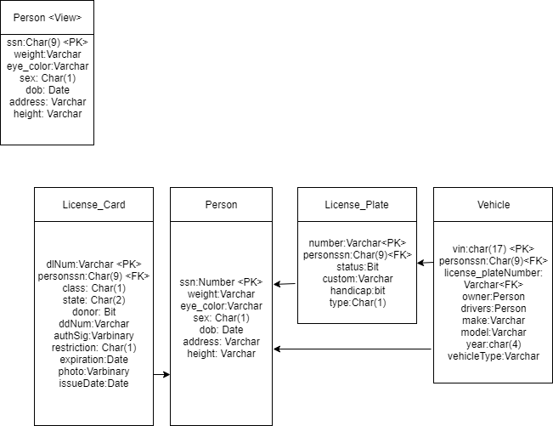
Data schema

Slide 7
Anticipated constraints and Calculated Risk
Constraints
Server must be SQL based
Project should contain multiple 1:1, 1:N and M:N relationships.
Calculated Risk
Risks | Probability | Impact | Level of Risk | Outcome
Miscommunication between team members | ●●●●○ |  |  | ●○○○○
Scheduling conflicts | ●●○○○ |  |  | ●○○○○
Burnout | ●● ○○ |  |  | ●●○○○
Developer not understanding tools | ●●●●○ |  |  | ●●●●○
◐

Slide 8
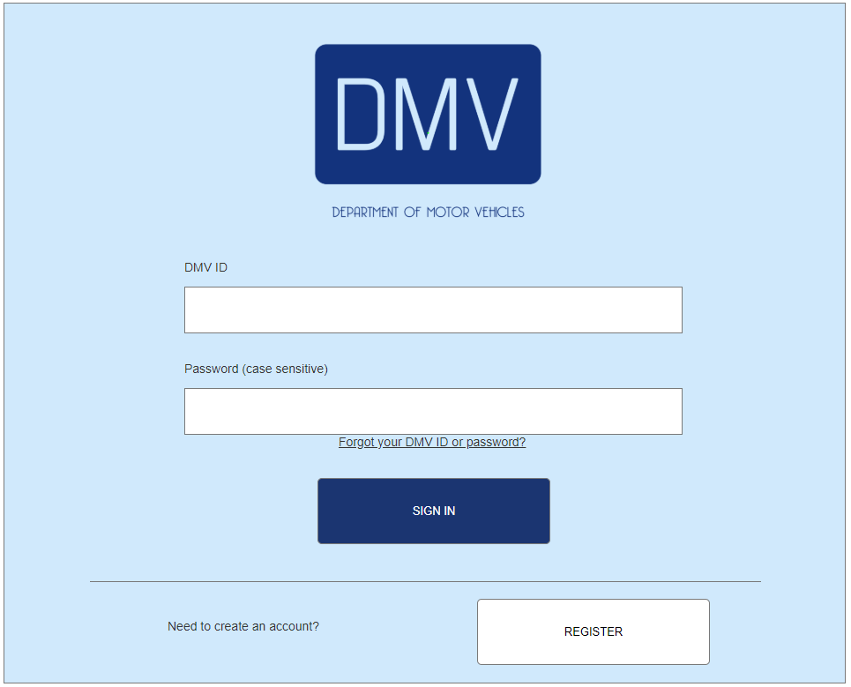
Front end design

Slide 9
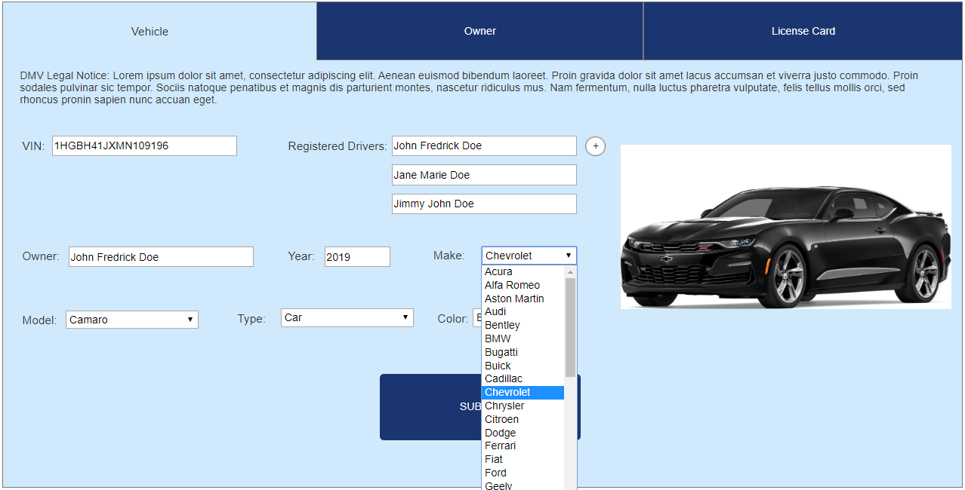
When the employee authentications into the portal, they will be greeted with three tabs along the top of the window. These tabs separate the three main functions of the employee.

Slide 10
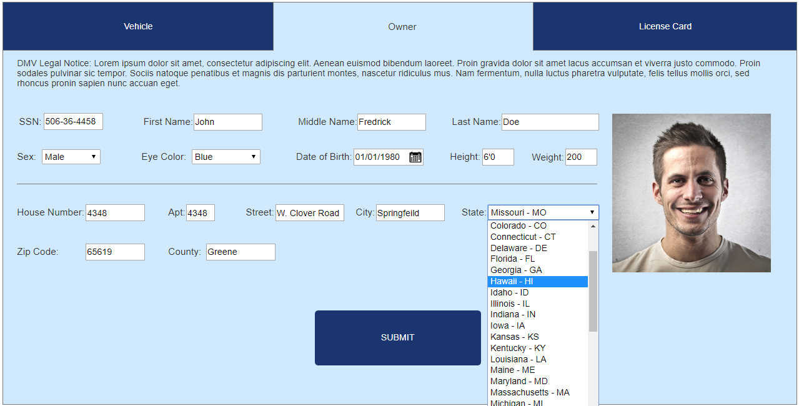
For the owner section of the UI we wanted to create a simple form that did not require scrolling. We wanted the employee’s to be able to tab through the options and be able to see all the information they have entered.

Slide 11
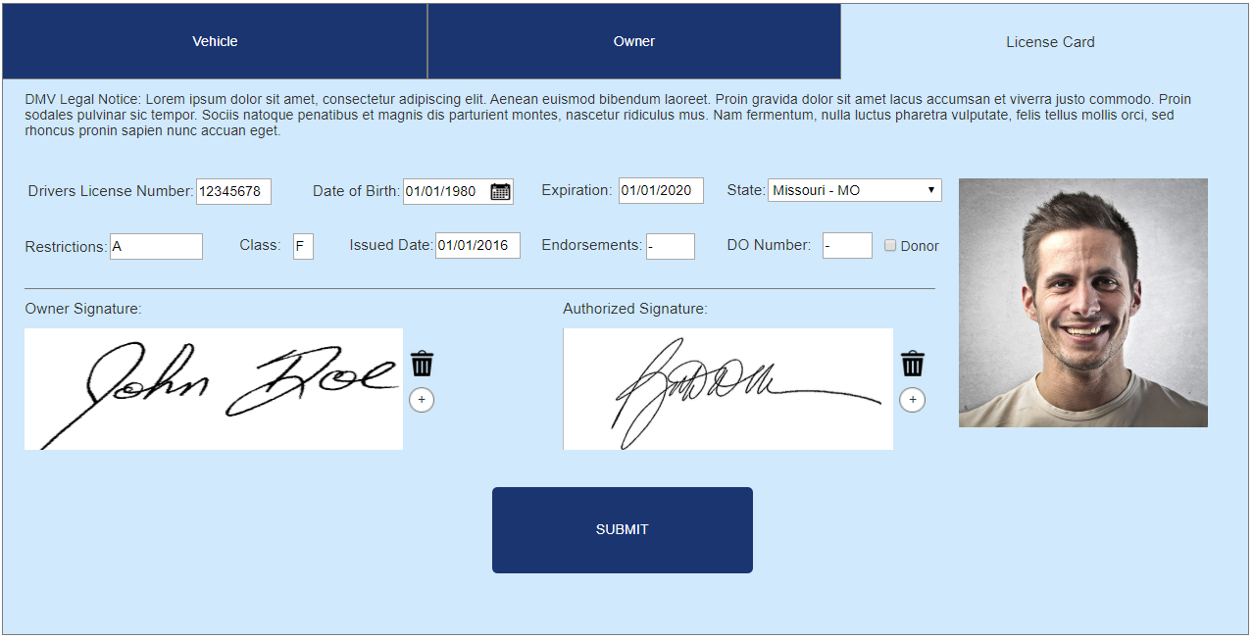
For the final tab of the interface this allows the employee to enter and review all customer data. For all these designs we followed UI gestalt rules to keep the employee from getting confused. This leads to task efficiency and subjective satisfaction.

Slide 12
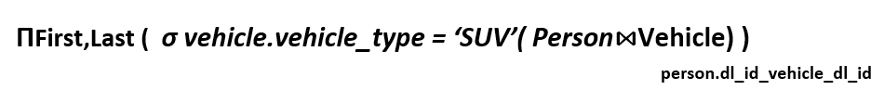
Queries and views
Query one :Get the name of all drivers who have a SUV

Slide 13
Queries and views
2. Query 2 :Find all owners who have more than 1 car

Slide 14
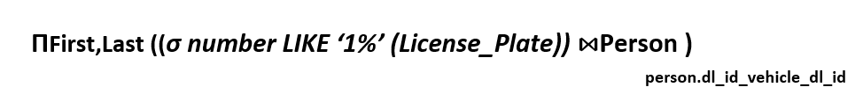
Queries and views
3. Query 3 :Find everyone who's license starts with 1

Slide 15
Queries and views
4. Query 4:Find the city of drivers of an SUV with license starting 12

Slide 16
Queries and views
5. Query 5:select dl_id from Person
ΠDL_ID(Person)

Slide 17
Normalization

